Slide 1

SESHADRI RAO GUDLAVALLERU ENGINEERING COLLEGE
ARTIFICIAL INTELLIGENCE & DATA SCIENCE
Machine Learning Project
on
Coral Health Trends: Predicting the Path to Sustainability
1.M. KEERTHI (22481A5469)
3. S .V. JAHNAVI (22481A5498)
2. SK . SAJIYA ANZUM (22481A54A4) 4. T.ANUSHA (22481A54B3)
Under the Guidance of:
MRS. Sushma Latha M.Tech
Assistant Professor

Slide 2
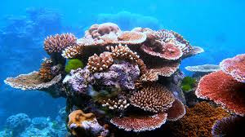
Coral Health Trends: Predicting the Path to Sustainability
Notes:
2

Slide 3
Introduction: Coral Reefs Under Threat
Importance of Coral Reefs
Current Threats
Biodiversity hotspots
Climate change
Coastal protection
Pollution
Economic value
Overfishing
Coral reefs face unprecedented threats. These challenges endanger marine life. Action is needed to reverse these destructive trends. Effective conservation is crucial.
Notes:
3

Slide 4
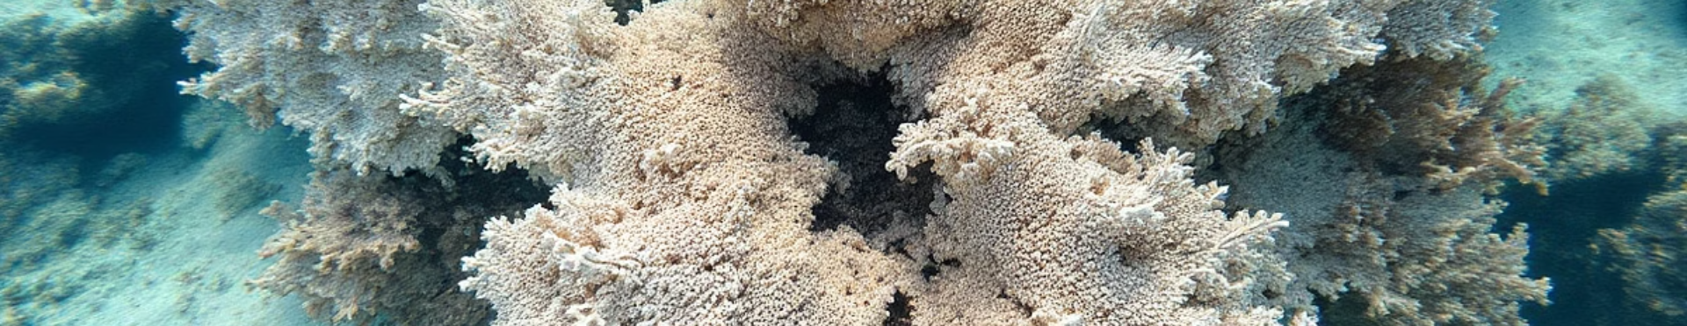
Problem Statement: Declining Coral Health
Coral Bleaching
Ocean Acidification
Disease Outbreaks
Rising ocean temperatures cause bleaching. Corals expel symbiotic algae. This leads to starvation and death.
Increased CO2 levels lower pH. This hinders coral calcification. Growth and structural integrity are compromised.
Stress weakens coral immune systems. Diseases spread rapidly, devastating populations. Vigilance is key.
Coral reefs are experiencing severe decline. Understanding these challenges is paramount. It informs targeted interventions.
Notes:
4

Slide 5
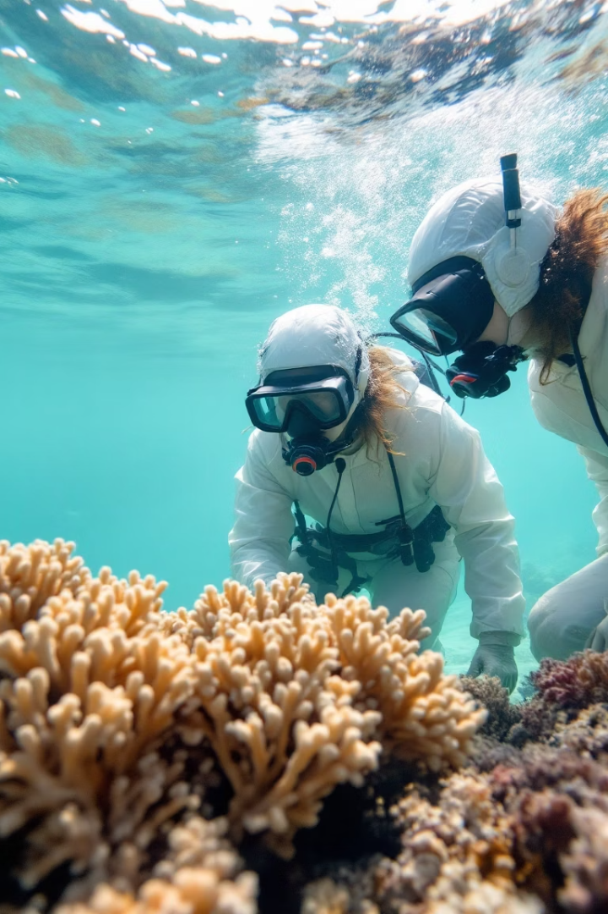



Objectives: Assessing Coral Health
Monitoring
Analysis
Prediction
Track key indicators of coral health. Regular monitoring is vital.
Analyze data to identify trends and patterns. Inform adaptive strategies.
Develop models to forecast future health. Guide proactive measures.
Our goal is to comprehensively assess coral health. Predictive modeling guides future conservation efforts. Data-driven insights will inform effective actions.
Notes:
5

Slide 6




Objectives: Promoting Sustainability
Reduce Pollution
Minimize land-based runoff. Implement waste management practices.
Manage Fishing
Enforce sustainable fishing practices. Protect key species from exploitation.
Mitigate Climate Change
Reduce carbon emissions. Support global climate agreements for coral well-being.
Sustainability hinges on addressing key threats. Pollution control is critical. Climate mitigation are vital for resilience.
Notes:
6

Slide 7






Working Procedure: Predictive Modeling
Data Collection
Gather environmental and biological data.
Model Development
Create predictive algorithms and frameworks.
Validation
Test model accuracy with historical data.
Forecasting
Predict future coral health scenarios.
Predictive modeling informs targeted conservation. Data drives informed action. Validation is crucial for reliability.
Notes:
7

Slide 8
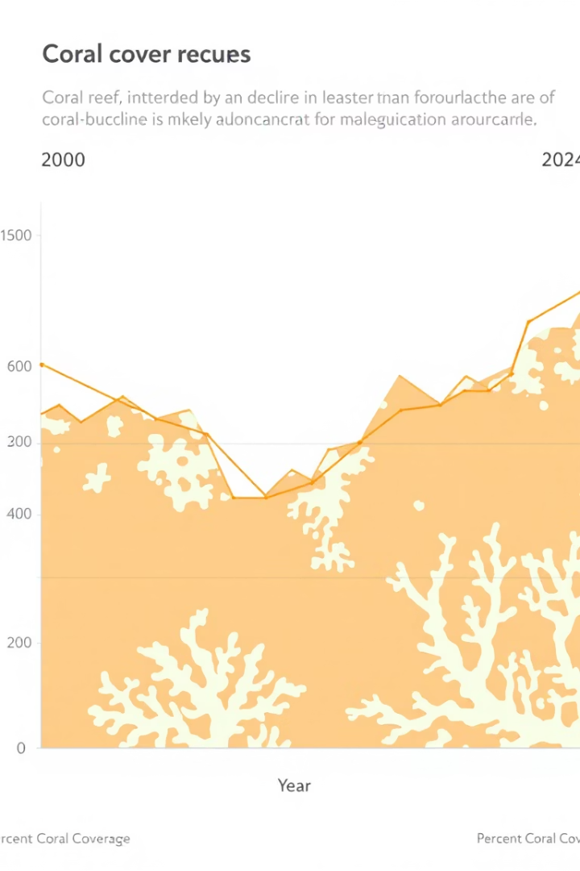
Results: Health Indicators
85%
40%
Coral Cover Decline
Bleaching Increase
Significant loss observed over the last 3 decades.
Frequency of bleaching events on the rise.
15%
Disease Prevalence
Increased incidents of coral diseases reported. Early warning systems are vital.
Coral cover is declining rapidly. Bleaching events are more frequent. Disease outbreaks are devastating populations.
Notes:
8

Slide 9
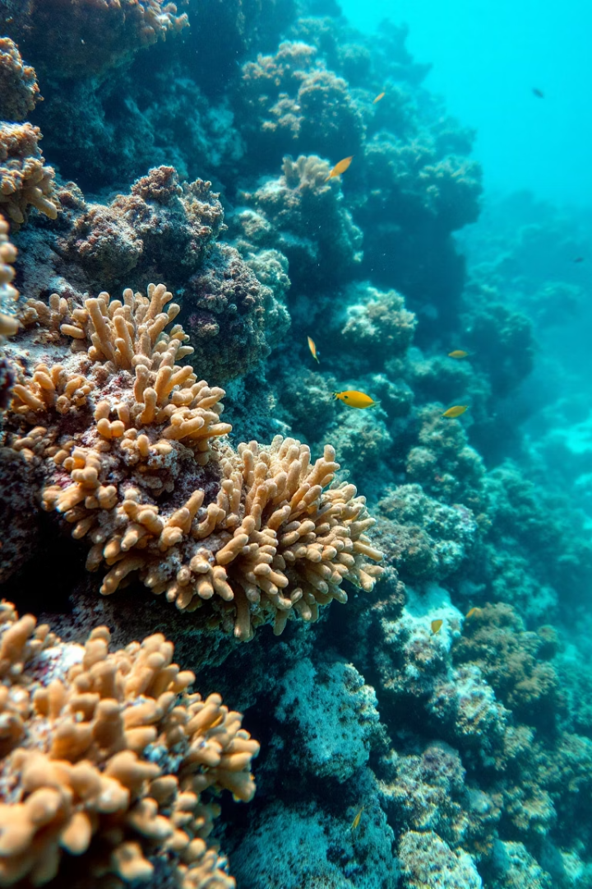
Conclusion: Urgent Action Required
Address Climate Change
Reduce emissions to lower ocean temperatures. Global collaboration is essential.
Control Pollution
Improve water quality through effective waste management.
Implement Sustainable Practices
Promote responsible tourism and fishing for conservation.
Protecting coral reefs is possible. Collaboration is key. Proactive measures support coral ecosystems.
Notes:
9

Slide 10
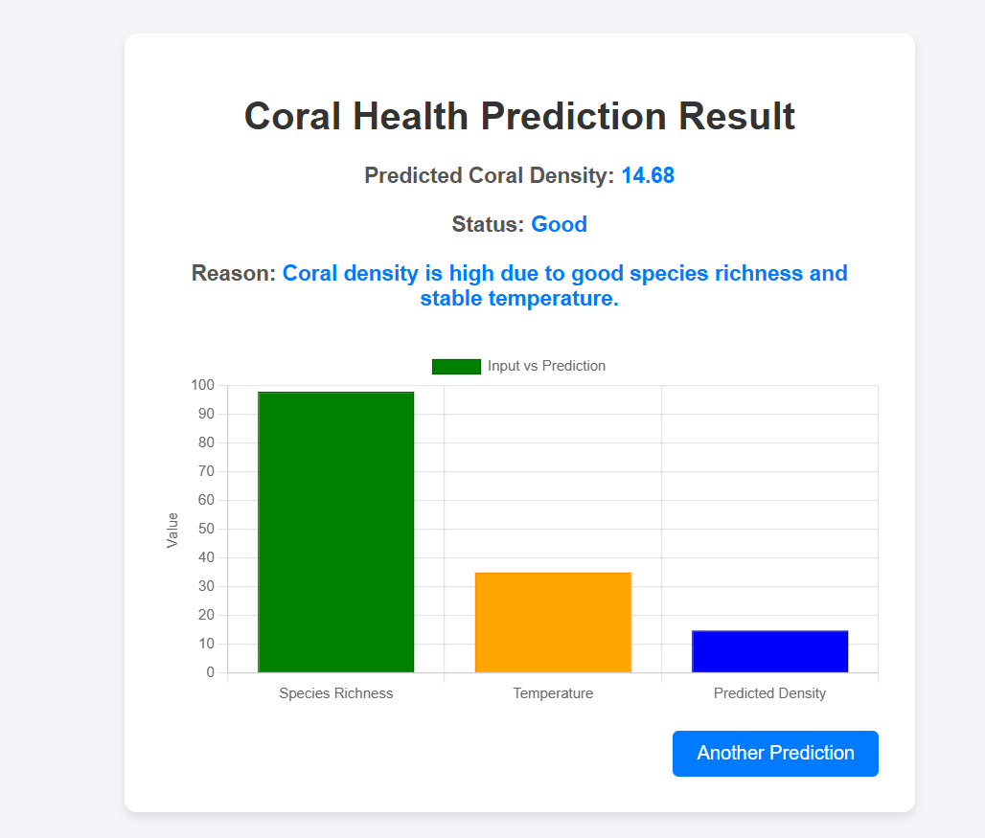
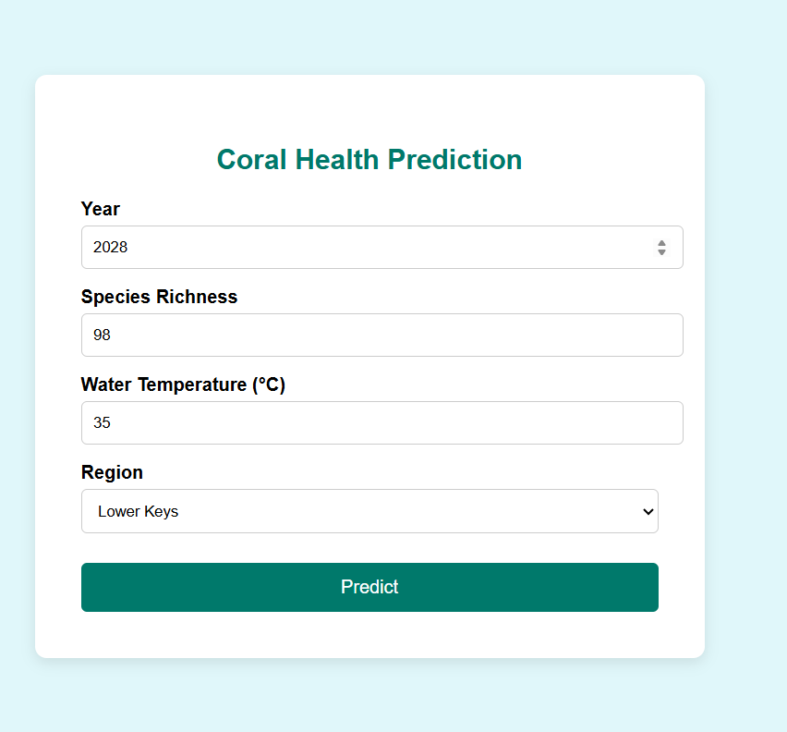
WEBSITE :

Slide 11
Challenges and Solutions
Data Scarcity
Model Complexity
Insufficient long-term data. Solution: Increased monitoring efforts. Fill data gaps for informed models.
Complex environmental interactions. Solution: Refined predictive models. Continuous model refinement enhances results.
Overcoming challenges requires collaboration. Investing in data and refining models are key to progress. Innovative solutions enhance resilience.
Notes:
10

Slide 12



Thank You
Notes:
11

